Slide 1

Welcome to

Slide 2
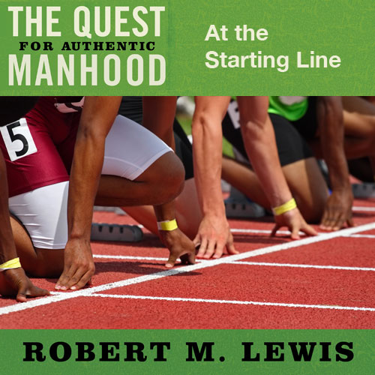
Session One

Slide 3
 | Men’s Fraternity One | Men’s Fraternity Two | Men’s Fraternity Three
NAME
FOCUS
CHIEF ELEMENTS
MAJOR CHALLENGES
PASSION

Slide 4
 | Men’s Fraternity One | Men’s Fraternity Two | Men’s Fraternity Three
NAME | The Quest for Authentic Manhood | Winning at Work and Home | The Great Adventure
FOCUS
CHIEF ELEMENTS
MAJOR CHALLENGES
PASSION

Slide 5
 | Men’s Fraternity One | Men’s Fraternity Two | Men’s Fraternity Three
NAME | The Quest for Authentic Manhood | Winning at Work and Home | The Great Adventure
FOCUS | A Man’s Core Identity | A Man’s Chief Responsibility | A Man’s Chosen Destiny
CHIEF ELEMENTS
MAJOR CHALLENGES
PASSION

Slide 6
 | Men’s Fraternity One | Men’s Fraternity Two | Men’s Fraternity Three
NAME | The Quest for Authentic Manhood | Winning at Work and Home | The Great Adventure
FOCUS | A Man’s Core Identity | A Man’s Chief Responsibility | A Man’s Chosen Destiny
CHIEF ELEMENTS | A Man’s Wounds; Definition of Manhood; Overview of Manhood Issues | How a Man Enjoys His Work; How a Man Relates Successfully to a Woman | Rediscovering the Adventure of Life; Understanding His Design; Developing a Satisfying Life Focus
MAJOR CHALLENGES
PASSION

Slide 7
 | Men’s Fraternity One | Men’s Fraternity Two | Men’s Fraternity Three
NAME | The Quest for Authentic Manhood | Winning at Work and Home | The Great Adventure
FOCUS | A Man’s Core Identity | A Man’s Chief Responsibility | A Man’s Chosen Destiny
CHIEF ELEMENTS | A Man’s Wounds; Definition of Manhood; Overview of Manhood Issues | How a Man Enjoys His Work; How a Man Relates Successfully to a Woman | Rediscovering the Adventure of Life; Understanding His Design; Developing a Satisfying Life Focus
MAJOR CHALLENGES | The Boy in You Must Die | The Man in You Must Step Forward | The Adventurer in You Must Live
PASSION

Slide 8
 | Men’s Fraternity One | Men’s Fraternity Two | Men’s Fraternity Three
NAME | The Quest for Authentic Manhood | Winning at Work and Home | The Great Adventure
FOCUS | A Man’s Core Identity | A Man’s Chief Responsibility | A Man’s Chosen Destiny
CHIEF ELEMENTS | A Man’s Wounds; Definition of Manhood; Overview of Manhood Issues | How a Man Enjoys His Work; How a Man Relates Successfully to a Woman | Rediscovering the Adventure of Life; Understanding His Design; Developing a Satisfying Life Focus
MAJOR CHALLENGES | The Boy in You Must Die | The Man in You Must Step Forward | The Adventurer in You Must Live
PASSION | Seizing Your Manhood | Establishing Your Manhood | Maximizing Your Manhood

Slide 9
Presuppositions
Manhood is in a state of confusion.
Confused men create major problems.

Slide 11
Presuppositions
Manhood is in a state of confusion.
Confused men create major problems.
Confused men settle for less.
There is no lofty vision of manhood that is compelling to men today.
The Bible has insight and answers to all of the above.

Slide 12


Slide 13
Promises
You will have a clear definition of manhood.
You will develop a new manhood language.
You will make significant personal discoveries about yourself.
You will make new friends who are pursuing a common goal.
You will have your own personalized manhood plan for achieving authentic manhood.

