Slide 1
Welcome to

Slide 2
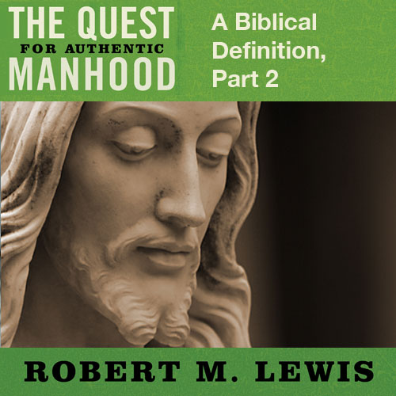
Session Eighteen

Slide 3
Four Defining Differences
The first Adam fell into passivity; the second Adam rejected passivity.
The first Adam disregarded his responsibilities; the second Adam accepted responsibility.

Slide 4
Four Defining Differences
He accepted responsibility for:
For a will to obey

Slide 5
“Jesus said to them, ‘My food is to do
the will of Him who sent Me, and to
accomplish His work’.”
John 4:34

Slide 6
“I delight to do Thy will, O my God;
Thy Law is within my heart.”
Psalm 40:8

Slide 7
“And He went a little beyond them and fell
on His face and prayed, saying ‘My Father,
if it is possible, let this cup pass from me;
yet not as I will, but as Thou wilt’.”
Matthew 26:39

Slide 8
Four Defining Differences
He accepted responsibility for:
For a will to obey
For a work to do

Slide 9
“I glorified Thee on the earth,
having accomplished the work
which Thou hast given Me to do.”
John 17:4

Slide 10
Four Defining Differences
He accepted responsibility for:
For a will to obey
For a work to do
For a woman to love

Slide 11
“Husbands, love your wives, just as
Christ also lived the church
and gave Himself up for her.”
Ephesians 5:25

Slide 12
Four Defining Differences
What causes a man to accept social and spiritual responsibility?
When it is clear from a young age that the primary responsibility for the social & spiritual well-being of others (namely wife, children) rests on him.
When he has been trained from an early age by the men in his life to recognize and assume these responsibilities.

Slide 13
Four Defining Differences
When he is honored, especially by other men, for accepting these responsibilities.
When he has been spiritually transformed in the heart by Jesus Christ to desire these responsibilities in order to honor God.

Slide 14
Four Defining Differences
The first Adam abandoned his post of leadership; the second Adam chose to lead courageously.
Men were created to lead, but it takes courage.
Jesus led where Adam didn’t
He set direction
He provided protection
He made provision

Slide 15
Four Defining Differences
To be a courageous leader, every man must master one significant obstacle: Feelings

Slide 16
“Like a city that is broken into and
without walls is a man who has
no control over his spirit.”
Proverbs 25:28

Slide 17
“Nothing can bring a man peace,
but the triumph of principles.”
Ralph Waldo Emerson

Slide 18
Four Defining Differences
The first Adam sought a great reward; the second Adam expected a great reward, God’s reward.

Slide 19
“…And let us run with endurance the race
that is set before us, fixing our eyes on
Jesus, the author and perfecter of the faith,
who for the joy set before Him endured
The cross, despising the shame, and
has sat down at the right hand of the
throne of God.”
Hebrews 12:1,2
(Jesus)

Slide 20
“I would have despaired unless I had
believed that I would see the goodness of
the Lord in the land of the living.”
Psalm 27:13
(David)

Slide 21
“By faith Moses, when he had grown up,
refused to be called the son of Pharaoh’s
daughter; choosing rather to endure ill
treatment with the people of God than to
enjoy the passing pleasures of sin;
considering the reproach of Christ greater
riches than the treasures of Egypt; for he
was looking to the reward.”
Hebrews 11:24-26
(Moses)

Slide 22
“I have fought the good fight, I have
finished the course, I have kept the faith;
in the future there is laid up for me the
crowns of righteousness, which the Lord,
the righteous Judge, will award to me on
that day; and not only to one, but also to
all who have loved his appearing.”
2 Timothy 4:7-8
(Paul)

Slide 23
“For bodily discipline is only of little profit,
but godliness is profitable for all things,
since it holds promise for the present life
and also for the life to come.”
1 Timothy 4:8

Slide 24
“And without faith it is impossible to please
Him, for he who comes to God must believe
that He is, and that He is a rewarder of
those who seek Him.”
Hebrews 11:6

Slide 25
A Real Man is One Who…
REJECTS PASSIVITY
ACCEPTS RESPONSIBILITY
LEADS COURAGEOUSLY
EXPECTS THE GREATER REWARD, GOD’S REWARD

