Slide 1
Welcome to

Slide 2
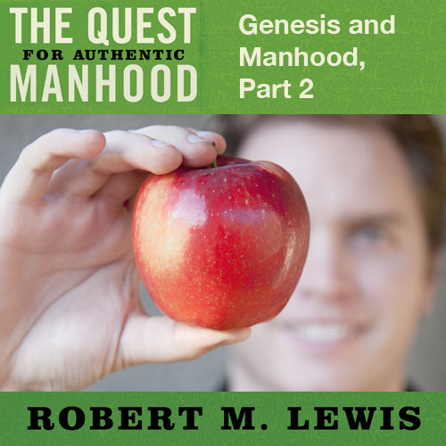
Session Sixteen

Slide 3
A Brief Review
Male domination is a
personal moral failure,
not a teaching of the Bible.

Slide 4
Genesis 2 - Manhood
Notice… Adam names his helper.

Slide 5
“And the man said, ‘This is now bone of my
bones, and flesh of my flesh; She shall be
called Woman, because she was
taken out of the Man.”
Genesis 2:23

Slide 6
Genesis 2 - Manhood
Notice… Adam names his helper.
Notice… It is the man who is told to leave and initiate a new household.

Slide 7
“For this cause a man shall leave his father
and his mother, and shall cleave to his wife;
and they shall become one flesh.”
Genesis 2:24

Slide 8
Genesis 3 - Manhood
Notice… The temptation seeks to corrupt and reverse God’s original social and spiritual order.

Slide 9
“Now the serpent was more crafty than any
beast of the field which the Lord God had
Made. And he said to the woman, ‘Indeed,
has God said, ‘You shall not eat from any
tree of the garden?’ And the woman said to
the serpent, ‘From the fruit of the trees of
the garden we may eat; but from the fruit
of the tree which is in the middle of the
garden, God has said, ‘You shall not eat
from it or touch it, lest you die.’”
Genesis 2:24

Slide 10
“And the serpent said to the woman, ‘You surely shall not die! For God knows that in the day you eat from it your eyes will be opened, and you will be like God, knowing good and evil.’ When the woman saw that the tree was good for food, and that it was a delight to the eyes, and that the tree was desirable to make one wise, she took from its fruit and ate; and she gave also to her husband with her, and he ate.”
Genesis 3:1-6

Slide 11
Genesis 3 - Manhood
Notice… The temptation seeks to corrupt and reverse God’s original social and spiritual order.
Notice… God holds Adam, not the woman, accountable for this first sin.

Slide 12
“And they heard the sound of the Lord God
walking in the garden in the cool of the day,
and the man and his wife hid themselves
from the presence of the Lord God among
the trees of the garden. Then the
Lord God called to the man,
and said to him ‘Where are you?’.”
Genesis 3:8-9

Slide 13
Genesis 3 - Manhood
Notice… Adam’s sin has an unacceptable passivity attached to it.

Slide 14
“God said to the man, ‘Have you eaten
from the tree I commanded you not to
eat?’ And the man said, ‘The woman who
Thou gavest to be with me, she gave me
from the tree, and I ate.’”
Genesis 3:11-12

Slide 15
Genesis 3 - Manhood
Notice… Adam’s sin has an unacceptable passivity attached to it.
Notice… Adam’s curse is based on the reversal of God’s original created order. (Eve’s curse is also based on her usurping God’s created order.)

Slide 16
“Then to Adam He said, ‘Because you have
listened to the voice of your wife, and have
eaten from the tree about which I
commanded you, saying, ‘You shall not eat
from it’: Cursed is the ground because of
you; in toil you shall eat of it all
the days of your life.’”
Genesis 3:17

Slide 17
Genesis 3 - Manhood
Notice… Adam’s sin unleashed the destructive curse of male domination.

Slide 18
“Your desire shall be for your husband,
and he shall rule over you.”
Genesis 3:16b

Slide 19
Genesis 3 - Manhood
Notice… Adam’s sin unleashed the destructive curse of male domination.
Notice… Adam dies.

Slide 20
“And the Lord God commanded the man, saying, ‘From any tree of the garden you may eat freely; but from the tree of knowledge of good and evil, you shall not eat, for in the day that you eat from it, you shall surely die.’”
Genesis 2:16-17

Slide 21
Genesis 3 - Manhood
Notice… Adam’s sin unleashed the destructive curse of male domination.
Notice… Adam dies.
This judgment of death also extends to all those who come after him. He, not Eve, is charged with the fall of the human race. Our depraved natures are due to Adam’s sin.

Slide 22
“Through Adam’s disobedience,
everyone was made a sinner.”
Genesis 5:19

Slide 23
Genesis 3 - Manhood
Notice… Adam renames his wife as a continued sign of his leadership even after the fall.

Slide 24
“Now the man called his wife’s name
Eve, because she was the
mother of all the living.”
Genesis 3:20

