Slide 1
Welcome to

Slide 2
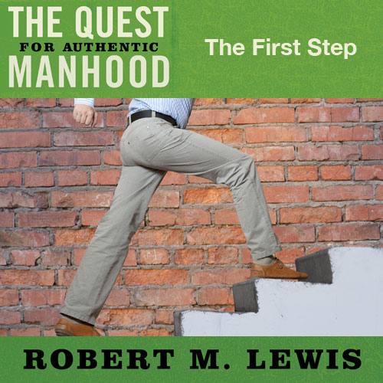
Session Three

Slide 3
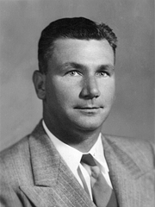
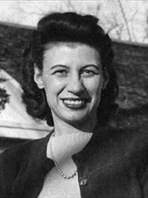
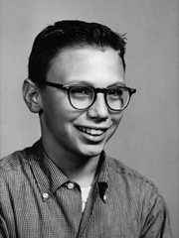
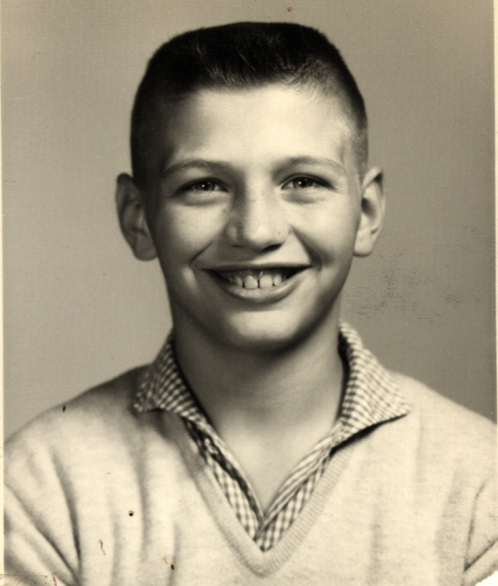
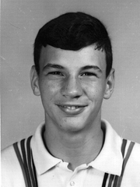

Slide 4
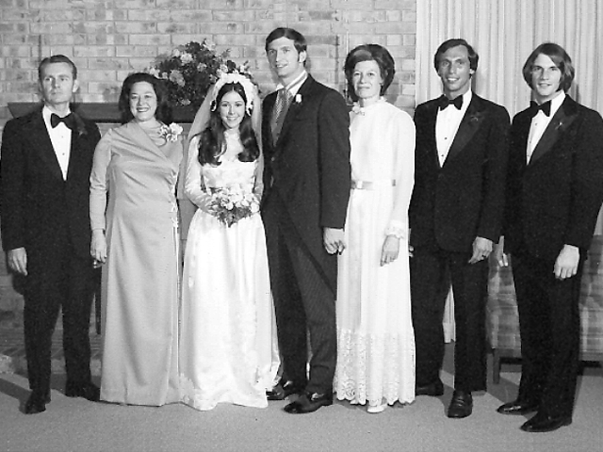

Slide 5
Looking Back…
My story is not unique. As a man, I am not alone.
When a boy fails to connect with his Dad, demons, of one kind or another, often fill the void.

Slide 6
Looking Back…
Many men have yet to reckon with their past or close out the unfinished business that still lives there.
Until a man unpacks his past and deals with the themes and pain that reside there, he can never be an authentic man.

Slide 7
Looking Back…
You cannot become a real man without help. There is no such thing as a “self-made man”.
For better or worse, we are all significantly shaped by the kind of family life we experienced.

