Slide 1
Welcome to

Slide 2
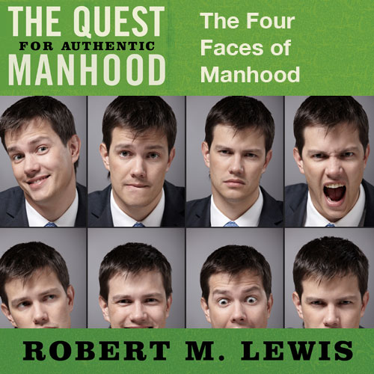
Session Two

Slide 3
Manhood’s Four Faces
Face #1: The King
Reflecting: Righteous Energy

Slide 4
Observations
All too often, these honorable
faces of manhood are
replaced by ugly caricatures.

Slide 5
Manhood’s Four Faces
Face #1: The King
Characterized by:
Strong Convictions
Courageous Moral Choices
A Servant Spirit
Righteous Leadership

Slide 6
Manhood’s Four Faces
Face #1: The King
Seen in Scripture:
“But the path of the righteous
is like the light of dawn that
shines brighter until
the full day.”
Proverbs 4:18

Slide 7
Manhood’s Four Faces
Face #1: The King
Seen in Scripture:
“A righteous man who
walks in his integrity–
How blessed are his
sons after him.”
Proverbs 20:7

Slide 8
Manhood’s Four Faces
Face #2: The Warrior
Reflecting: Conquering Energy

Slide 9
Manhood’s Four Faces
Face #2: The Warrior
Characterized by:
Initiative
Protecting
Providing
Persevering
Fighting

Slide 10
Manhood’s Four Faces
Face #2: The Warrior
Seen in Scripture:
“Pursue in righteousness, godliness, faith, love perseverance and gentleness.
Fight the good fight of faith;
take hold of the eternal life to
which you were called.”
1 Timothy 6:11-12

Slide 11
Manhood’s Four Faces
Face #3: The Lover
Reflecting: Romantic Energy

Slide 12
Manhood’s Four Faces
Face #3: The Lover
Characterized by:
Tenderness
Sensitivity
Sacrificial Care
Emotional Openness
Physical Affection

Slide 13
Manhood’s Four Faces
Face #3: The Lover
Seen in Scripture:
“Husbands, love your wives
just as Christ also loved the
church and gave Himself up for her.”
Ephesians 5:25

Slide 14
Manhood’s Four Faces
Face #4: The Friend
Reflecting: Connecting Energy

Slide 15
Manhood’s Four Faces
Face #4: The Friend
Characterized by:
Loyalty
Accountability
Challenge
Fun

Slide 16
Manhood’s Four Faces
Face #4: The Friend
Seen in Scripture:
“A friend loves at all times,
and a brother is born for adversity”
Proverbs 17:17

Slide 17
Manhood’s Four Faces
Face #4: The Friend
Seen in Scripture:
“Iron sharpens iron,
so one man sharpens another.”
Proverbs 27:17

Slide 18
Observations
All too often, these honorable
faces are replaced
with ugly caricatures.

Slide 19
Observations
K
Abdicator
Tyrant
Cold
L
Critical
Loner
F
User
Wimp
W
Destroyer

Slide 20
Observations
Because of our morally-compromised culture, many men today lack a King.
Without a King, the Warrior becomes unrestrained, hurting lives, including his own, in the process.

Slide 21
Observations
Our increasingly feminized culture
has emasculated the Warrior in
many young men.
The result has been the creation
of the soft male, indecisive as to direction, weak as to leadership.

Slide 22
Observations
Our world is desperate
for the four-face balance
of real manhood!

