Slide 1
Welcome to

Slide 2
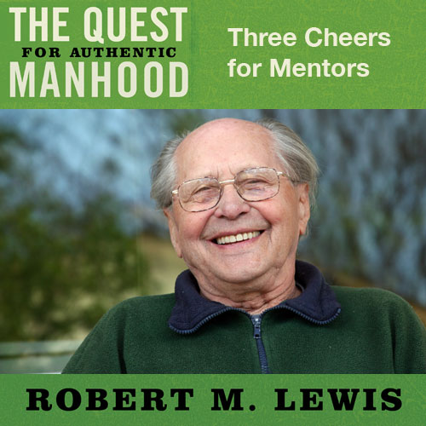
Session Ten

Slide 3
From Dad to Whom?
Dad can only take you so far.
Male mentors are specialists.

Slide 4
Comments About a Mentor
He is one who supports rather than competes with you.
He is one who is primarily a cheerleader, not a critic.
He is one who seeks to encourage the development of your gifts while seeking to protect you from costly mistakes.

Slide 5
Comments About a Mentor
He is one who admires and delights in you because he instinctively recognizes your value and untapped potential.
He is not necessarily a close friend, but a close confidant.

Slide 6
What a Mentor Brings
Wisdom through experience
Warnings
A belief in you
Cheers for your achievement
In some instances…a proven hero

Slide 7
“Now when Moses’ father-in-law saw all that he was doing the people, he said,
‘What is this thing you are doing for the
people? Why do you alone sit as judge and
all the people stand about you from
morning until evening? The thing you are
doing is not good. You will surely wear out
both yourself and these people who are
with you, for the task is too heavy for you;
you cannot do it alone. Now listen to me
and I shall give you counsel.’”
Exodus 18:14, 17-19

Slide 8
“Having so fond an affection for you, we
are well pleased to impart to you not only
the gospel of God, but also our own lives…
just as you know how we were exhorting
and encouraging and imploring each one of
you as a father would his own children, so
that you would walk in a manner worthy of
the God who calls you into His own
kingdom and glory.”
1 Thessalonians 2:8, 11-12

Slide 9
Ten Marks of a Mentor
This man clearly has what you personally need.
He chooses to cultivate a relationship with you.
He is willing to take a chance on you.
He is respected by other men.
He has a network of resources.
He is consulted by others.
He both talks and listens.

Slide 10
Ten Marks of a Mentor
He is consistent in his lifestyle.
He is able to diagnose your real need.
His is concerned with your interests.

Slide 11
For the Mentor
Closes the loop on a man’s life cycle.
Connects older and younger men in a symbiotic relationship.
Allows a man to teach naturally, from experience, which younger men desperately need and want.
Gives older men a significant purpose in the second half of life.
Adds a missing satisfaction to an older man’s life.

Slide 12
For His Protégé
Hope
Wisdom
A bigger personal vision
Encouragement

Slide 13
Want to be a Mentor?
Make a list of your strengths and experiences you can bless a younger man’s life with. This is most important.
Determine how much time you have to give.
Pray for and choose a young man (or men) you want to be with and reach out to him.
If you “connect”, initiate some regular time together until the protégé has what he needs. Then let him go.

Slide 14
Need, but Lack, a Mentor
Pray for wisdom and guidance.
Go and ask courageously.
Don’t get discouraged if you are turned down.
Get a group and ask an older man to “mentor us”.

