Slide 1
Welcome to

Slide 2
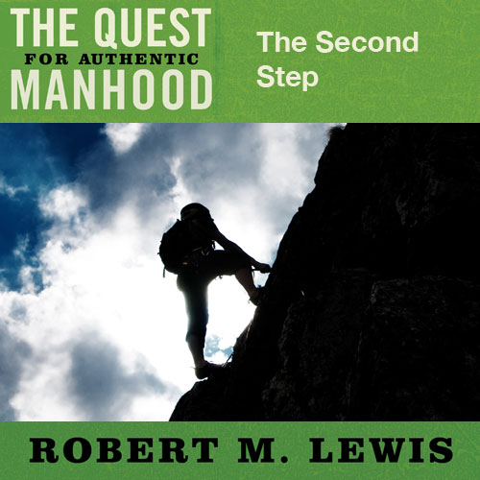
Session Four

Slide 3
Why Men Struggle Today
Some of it has to do with society.
Some of it has to do with family dynamics.
Some of it has to do with Dad.

Slide 4
Three Critical Issues
Addressing the unfinished business of my past.
What do we mean by wound?
A wound is… any unresolved issue where lack of closure adversely impacts and shapes the direction and dynamics of a man’s life now.

Slide 5
Three Critical Issues
Unpacking the past: Five wounds men must deal with
The Absent Father Wound
The Overly Bonded with Mother Wound
The All Alone Wound
The Lacking of a Manhood Vision Wound
The Heart Wound

Slide 6
Why Men Struggle Today
Addressing the unfinished business of my past.
Establishing a clear and compelling manhood vision.
Creating a high impact, workable plan for my life.

