Slide 1

Welcome to

Slide 2

Session Twenty-Two

Slide 3
The Power of Dad
Three types of Parenting
    Absent Parenting
    Engaged Parenting
    Strategic Parenting

Slide 4
“The glory of sons in their fathers.”
Proverbs 17:6

Slide 5
Three Ingredients
The “DIG” = Dad’s Compelling Character
The “SET” = Dad’s Clear Instruction
The “SPIKE” = Dad’s Creative Ceremonies

Slide 6
Power of Ceremony
Memorable ceremonies are costly.
Memorable ceremonies ascribe value to the person being celebrated.
Memorable ceremonies employ symbols.
Memorable ceremonies involve others who are significant to the person being celebrated.
Memorable ceremonies empower a life with vision.

Slide 7


Slide 8


Slide 9
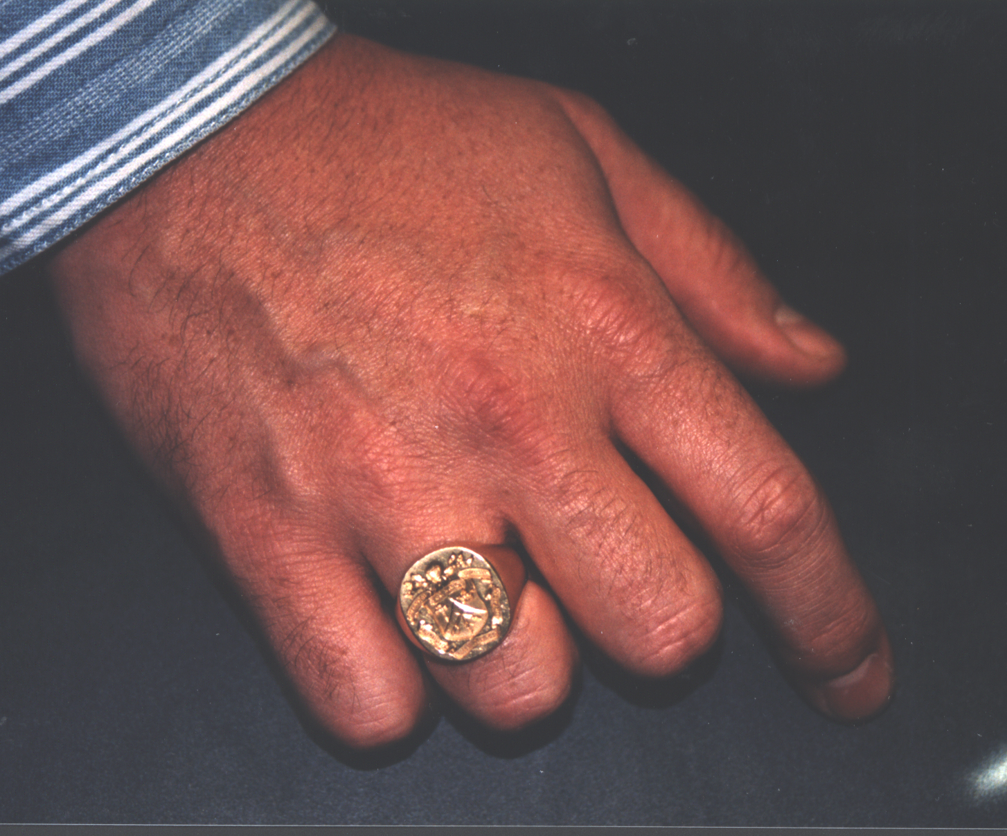

Slide 10
Initiating Your Son
Be creative!
Your son will love it!

