Slide 1
Welcome to

Slide 2
Session Five

Slide 3
Why Men Struggle Today
“And so I wasn’t there to see him as he
began to sink into himself. I wasn’t
here to sense that he might be drifting
toward that unimaginable realm of fantasy
and isolation that it would take nearly 30
years to recognize.”
Lionel Dahmer
A Father’s Story

Slide 4
 | 1960 | 1970 | 1980 | 1990
Children Living with biological father | 82.5
Children living apart from biological father | 17.5

Slide 5
 | 1960 | 1970 | 1980 | 1990
Children Living with biological father | 82.5 | 77.6
Children living apart from biological father | 17.5 | 22.4

Slide 6
 | 1960 | 1970 | 1980 | 1990
Children Living with biological father | 82.5 | 77.6 | 67.8
Children living apart from biological father | 17.5 | 22.4 | 32.2

Slide 7
 | 1960 | 1970 | 1980 | 1990
Children Living with biological father | 82.5 | 77.6 | 67.8 | 61.7
Children living apart from biological father | 17.5 | 22.4 | 32.2 | 38.3

Slide 8
“The glory of sons
is their fathers.”
Proverbs 17:6

Slide 9
Absent Father Wound
A Definition: An on-going emotional, social or spiritual deficit ordinarily met in a healthy relationship with Dad that must now be overcome by other means.

Slide 10
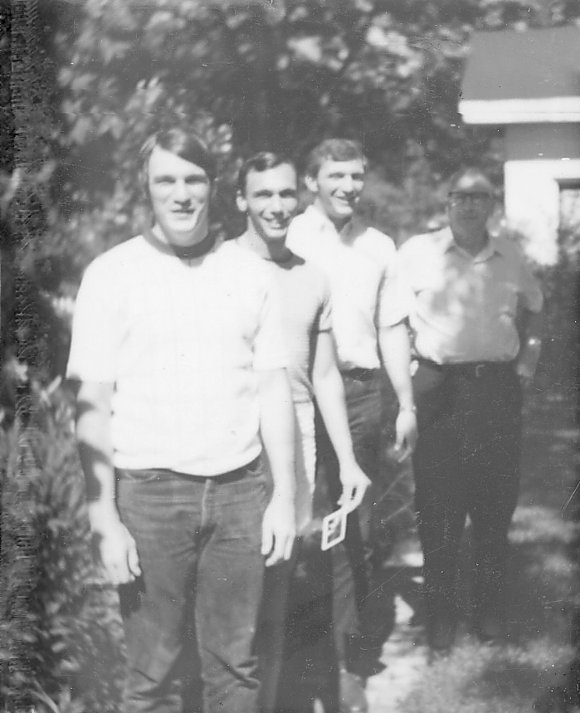

Slide 11
Absent Father Wound
Three words (or phrases) in remembering Dad.
You fill these blanks in about your Dad.
_________________________
_________________________
_________________________

Slide 12
Absent Father Wound
Results of the Absent Father Wound
Anger and pain

Slide 13
“And fathers, do not provoke
your children to anger, but bring
them up in the discipline and
instruction of the Lord.”
Ephesians 6:4

Slide 14
Absent Father Wound
Results of the Absent Father Wound
Anger and pain
Extreme behavior and addictions or obsessions

Slide 15
“Fathers, do not exasperate
your children, that they
may lose heart.”
Colossians 3:21

Slide 16
Absent Father Wound
Results of the Absent Father Wound
Anger and pain
Extreme behavior and addictions or obsessions
An inner sense of lostness or incompleteness
Homosexuality

Slide 17
What Every Son Needs
Time together
Life Skills

Slide 18
“Train up a child in the
way he should go; even
when he is old, he will
not depart from it.”
Proverbs 22:6

Slide 19
What Every Son Needs
Time together
Life Skills
Direction with solid “why” answers.

Slide 20
“And these words, which I am
Commanding you today, shall
be on your heart; and you shall
teach them to your sons and
shall talk of them when you sit in your house and when you walk
by the way and when you lie down
and when you rise up.”
Deuteronomy 6:6-7

Slide 21
What Every Son Needs
Time together
Life Skills
Direction with solid “why” answers
Convictions through modeling

Slide 22
“You are witnesses, and so is God,
how devoutly and uprightly and
blamelessly we behaved toward you
believers; just as you know how
we were exhorting and encouraging
and imploring each one of you
as a father would his own
children.”
1 Thessalonians 2:10-11

Slide 23
What Every Son Needs
Time together
Life Skills
Direction with solid “why” answers
Convictions through modeling
Dad’s heart

Slide 24
“This is my beloved Son,
in whom I am well-pleased;
listen to Him!”
Matthew 17:5

