Slide 1
Welcome to

Slide 2
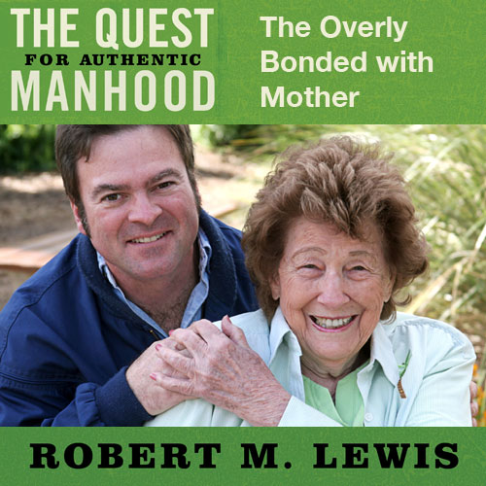
Session Seven

Slide 3
Breaks with Mom
From physical bondedness.
From emotional bondedness.

Slide 4
Breaks with Mom
FROM | TO | TO | TO

Slide 5
Breaks with Mom
FROM | TO | TO | TO
Oneness with Mom literally

Slide 6
Breaks with Mom
FROM | TO | TO | TO
Oneness with Mom literally | A healthy physical separation

Slide 7
Breaks with Mom
FROM | TO | TO | TO
Oneness with Mom literally | A healthy physical separation | A healthy emotional separation

Slide 8
Breaks with Mom
FROM | TO | TO | TO
Oneness with Mom literally | A healthy physical separation | A healthy emotional separation | Oneness with a woman relationally

Slide 9
“For this cause,
a man shall leave his father and mother, and shall cleave to his wife;
and they shall become one flesh.”
Genesis 2:24

Slide 10
Exploring Mother Wound
A Definition
An unhealthy emotional relationship with Mother that causes a son to either be threatened by the influence of women later on in life or to over-identify and become submissive to that influence.

Slide 11
Exploring Mother Wound
Important Characteristics
This wound is not blatant, but subtle.
This wound is not one of abuse, neglect, or absenteeism, but a wound disguised as love and care.
This is not a wound of inattention, but over-attention.
This wound looks like love, but feels like control.

Slide 12
Exploring Mother Wound
This wound is so powerful, it can wrongly shape or warp the masculine psyche.

Slide 13
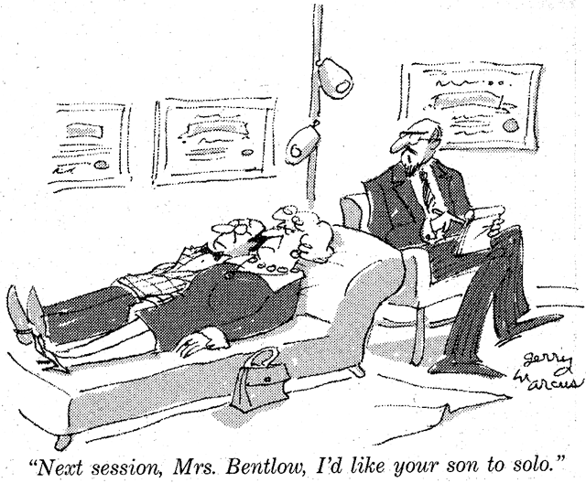

Slide 14
How this Wound Occurs
It often begins with an absent or distant father.

Slide 15
THE FEMINIZED MAN

Slide 16
How this Wound Occurs
It often begins with an absent or distant father.
It can also be inflicted by one of four types of Moms.

Slide 17
Four Types of Moms
Ignorant Moms.
Needy, hurting Moms.
Unwilling to release Moms.
Fill in the gaps Moms.

Slide 18
Two Responses
One tendency for boys growing up in
such circumstances is to rebel against women who are authorities over
them and become socially
disruptive- irresponsible in family and
work commitments, overly assertive
about their manly prowess, especially in sexual areas, or leading lives characterized by violence and crime, alcoholism, and other addictions.

Slide 19
Two Responses
Another tendency for young men is to identify with the adult women who are authorities in their lives and learn to behave or react in ways that are more appropriate to women than to men. To the extent that young males take either option, they do not learn the discipline, the responsibility, and the character involved in being a man.
Prentice Tipton, “The Crisis in Black Manhood”

Slide 20
Two Reponses
Men become dominant and controlling toward women.
Men become passive and submissive toward women.

