Slide 1
Welcome to

Slide 2
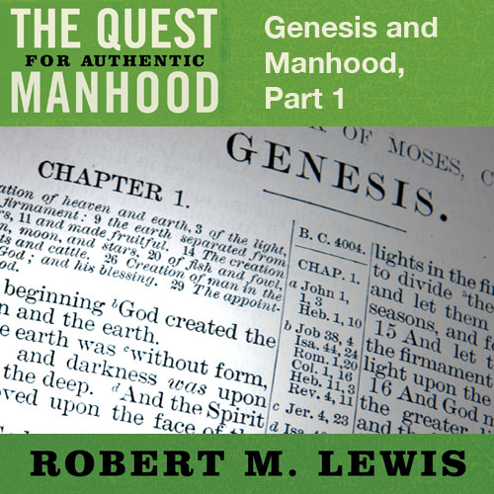
Session Fifteen

Slide 3
The Genesis Myth
Myth is not synonymous with fiction.
A real myth explains and measure our reality.
The “myth” of Genesis explains and measures manhood, both in its original ideals and in it ongoing fallenness.
Genesis describes our ancestral roots.

Slide 4
GENESIS

Slide 5
GENESIS
1
Wide Angle

Slide 6
GENESIS
1
2
Wide Angle
Close Up

Slide 7
GENESIS
1
2
Wide Angle
Close Up
Tight Focus
3

Slide 8
Genesis 1 - Manhood
It speaks of male and female value.

Slide 9
“Then God said, ‘Let Us make man in Our
images, according to Our likeness; and let
them rule over the fish of the sea and over
the birds of the sky and over the cattle and
over all the earth, and over every creeping
thing that creeps on the earth.’ And God
created man in His own image, in the
image of God He created him; make and
female He created them.”
Genesis 1:26-27

Slide 10
Genesis 1 - Manhood
It speaks of male and female value.
Image
Equally endowed / equally valuable
Unique and special

Slide 11
Genesis 1 - Manhood
It speaks of male and female calling.

Slide 12
“And God blessed them; and God said to
them, ‘Be fruitful and multiply, and fill the
earth, and subdue it; and rule over the fish
of the sea and over the birds of the sky,
and over every living thing that
moves on the earth.’”
Genesis 1:28

Slide 13
Genesis 1 - Manhood
It speaks of male and female calling.
“Be fruitful / multiply / fill the earth”
“Subdue the earth”
“Rule over the earth”
It “hints” at very important social structure.

Slide 14
“Then God said, ‘Let Us make man in Our
image, according to Our likeness…’ And
God created man in His own image, in the
image of God He created them; male and
female He created them.”
Genesis 1:26-27

Slide 15
“He created them male and female, and He blessed them and named them ‘Man’ in the day when they were created.”
Genesis 5:2

Slide 16
Genesis 2 - Manhood
Notice… Adam was created first.

Slide 17
“Then the Lord God formed man of dust
from the ground, and breathed into his
nostrils the breath of life; and man
became a living being.”
Genesis 2:7

Slide 18
“But I do not allow a woman to teach or
exercise authority over a man, but to
remain quiet. For it was Adam who was
first created, and then Eve.”
1 Timothy 2:12-13

Slide 19
Genesis 2 - Manhood
Notice… Adam was created first.
Notice… Adam is given an occupation and responsibility before Eve’s creation.

Slide 20
“Then the Lord God took the man
and put him into the garden of Eden
to cultivate it and keep it.”
Genesis 2:15

Slide 21
Genesis 2 - Manhood
Notice… Adam was created first.
Notice… Adam is given an occupation and responsibility before Eve’s creation.
Notice… Adam in instructed by God with the responsibility of leading with His Word.

Slide 22
“And the Lord God commanded the man,
Saying, ‘From any tree of the garden you
may eat freely; but from the tree of the
knowledge of good and evil you shall not
eat, for in the day that you eat from
it you shall surely die.’”
Genesis 2:16-17

Slide 23
“Husbands, love your wives…
with the Word.”
Ephesians 5:25-26

Slide 24
Genesis 2 - Manhood
Notice… Adam names the animals, a signal of his leadership over creation.

Slide 25
“And out of the ground the Lord God
formed every beast of the field and every
bird of the sky; and brought them to the
man to see what he would call them;
and whatever the man called a
living creature, that was its name.”
Genesis 2:19

Slide 26
Genesis 2 - Manhood
Notice… Adam names the animals, a signal of his leadership over creation.
Notice… Adam is give a “helper suitable for him,” a title that offers further evidence of God’s original core social identity for the man and the woman.

Slide 27
“Then the Lord God said,
‘It is not good for the man to be
alone; I will make him a helper
suitable for him’.”
Genesis 2:18

Slide 28
“But I want you to understand that
Christ is the head of every man,
and the man is the head of a woman,
and God is the head of Christ.”
1 Corinthians 11:3

