Slide 1

Welcome to

Slide 2
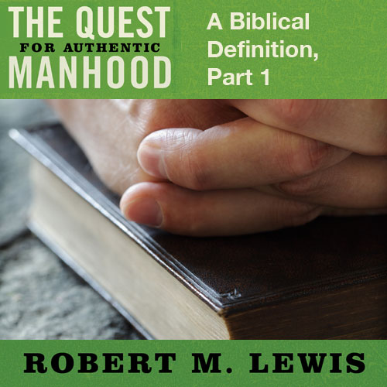
Session Seventeen

Slide 3
Key Reminders
Men were created by God to be social and spiritual leaders.
    When men abandon this pursuit or when this pursuit is taken away from them… chaos ensues.

Slide 4
“For behold, the Lord God of hosts is going to
remove… the mighty man and the warrior, the
judge and the prophet, the diviner and the elder,
the captain of fifty and the honorable man. And
I will make mere lads their princes and
capricious children will rule over them, and the
people will be oppressed, each one by another
and each one by his neighbor; The youth will
storm against the elder and the inferior against
the honorable. When a man lays hold of his
brother in his father’s house, saying ‘You have a
cloak, you shall be our ruler, and these ruins
will be under your charge.’

Slide 5
He will protest on that day saying, ‘I will not be
your healer.’ For Jerusalem has stumbled and
Judah has fallen. The expression of their faces
bears witness against them. And they display
their sin like Sodom; they do not even conceal it.
Woe to them! For they have brought evil on
themselves. O My people! Their oppressors are
children, and women rule over them.”
Isaiah 3:1-12

Slide 6
Seen Today
Men become confused, directionless, troubled
Women suffer and must fight for their equality and protection
Family life is harmed; children are hurt
Society becomes troubled.

Slide 7
Key Reminders
The male leadership of Genesis is not natural, but supernatural, with specific responsibilities.
    Will to obey
    Work to do
    Woman to love and care for

Slide 8
Key Objections
Male leadership is cultural, not creational.

Slide 9
“But I want you to understand that Christ is
the head if every man, and the man is the
head of a woman, and God is the head of
Christ. For man does not originate from
woman, but woman from man.”
1 Corinthians 11:3, 8

Slide 10
Key Objections
Male leadership is cultural, not creational.
Make leadership is a result of the fall, not a result of God’s design.

Slide 11
“There is neither Jew nor Greek, there is
neither slave nor free man, there
is neither male nor female; for you are all
one in Christ Jesus.”
Galatians 3:28

Slide 12
Two Men
Adam and Jesus Christ
Adam and Christ stand against each other
as two great figures are the entrance
Of two worlds, two creations, the old
and the new… And in their actions and fates, lie the decisions for all who
belong to them, because all men
are comprehended in them.
Theologian Hermann Ridderbos

Slide 13
“So also it is written, ‘The first man, Adam,
became a living soul.’ The last Adam became a
life-giving spirit. However, the spiritual is not
first, but the natural; then the spiritual. The
first man is from earth, earthy; the second
man is from heaven. As is the earthy, so also
are those who are earthy; and as is the
heavenly, so also are those are
heavenly. And just as we have borne the
image of the earthy, we shall also bear the
image of the heavenly.”
1 Corinthians 15:45-49

Slide 14
Two Men
They are leaders of two distinct spiritual destinies for all humanity.

Slide 15
“For if by the transgression of the one, death
reigned through the one, much more those who
receive the abundance of grace and of the gift of
righteousness will reign in life through the One,
Jesus Christ. So then as through one
transgression here resulted condemnation to all
men; even so through one act of righteousness
there resulted justification of life to all men. For
as through the one man’s disobedience the
Many were made sinners, even so
through the obedience of the One, the
many will be made righteous.”
Romans 5:17-19

Slide 16
Two Men
They are leaders of two distinct spiritual destinies for all humanity.
They are also leaders of two distinct masculine destinies.

Slide 17
The First Adam
Set on a natural course
Based on personal instinct, human reason, and reaction… not revelation!
That draws life from others
Without transcendent meaning
“A living soul”… nothing more

Slide 18
The Second Adam
Set on a heavenly course
Yielded to revelation… not personal instinct, human reason, or reaction
That empowers others
Full of transcendent meaning
“A life-giving spirit”

Slide 19
How These Play Out
ADAM (Conventional Manhood) | CHRIST (Authentic Manhood)

Slide 20
How These Play Out
ADAM (Conventional Manhood) | CHRIST (Authentic Manhood)
What a man does

Slide 21
How These Play Out
ADAM (Conventional Manhood) | CHRIST (Authentic Manhood)
What a man does Competition with other men

Slide 22
How These Play Out
ADAM (Conventional Manhood) | CHRIST (Authentic Manhood)
What a man does Competition with other men Temporal power

Slide 23
How These Play Out
ADAM (Conventional Manhood) | CHRIST (Authentic Manhood)
What a man does Competition with other men Temporal power Personal rewards

Slide 24
How These Play Out
ADAM (Conventional Manhood) | CHRIST (Authentic Manhood)
What a man does Competition with other men Temporal power Personal rewards Self

Slide 25
How These Play Out
ADAM (Conventional Manhood) | CHRIST (Authentic Manhood)
What a man does Competition with other men Temporal power Personal rewards Self Success

Slide 26
How These Play Out
ADAM (Conventional Manhood) | CHRIST (Authentic Manhood)
What a man does Competition with other men Temporal power Personal rewards Self Success | What a man is

Slide 27
How These Play Out
ADAM (Conventional Manhood) | CHRIST (Authentic Manhood)
What a man does Competition with other men Temporal power Personal rewards Self Success | What a man is Community with other men

Slide 28
How These Play Out
ADAM (Conventional Manhood) | CHRIST (Authentic Manhood)
What a man does Competition with other men Temporal power Personal rewards Self Success | What a man is Community with other men Transcendent purpose

Slide 29
How These Play Out
ADAM (Conventional Manhood) | CHRIST (Authentic Manhood)
What a man does Competition with other men Temporal power Personal rewards Self Success | What a man is Community with other men Transcendent purpose Eternal rewards

Slide 30
How These Play Out
ADAM (Conventional Manhood) | CHRIST (Authentic Manhood)
What a man does Competition with other men Temporal power Personal rewards Self Success | What a man is Community with other men Transcendent purpose Eternal rewards Others

Slide 31
How These Play Out
ADAM (Conventional Manhood) | CHRIST (Authentic Manhood)
What a man does Competition with other men Temporal power Personal rewards Self Success | What a man is Community with other men Transcendent purpose Eternal rewards Others Significance

Slide 32
Defining Differences
The first Adam fell into passivity; the second Adam (Christ) rejected passivity.

Slide 33
“When the woman saw that the tree was
good for good, and that it was a delight to
the eyes, and that the tree was desirable to
make one wise, she took from its fruit and
ate; and she gave also to her
husband with her, and he ate.”
Genesis 3:6

Slide 34
“Although He existed in the form of God,
did not regard equality with God a thing to
be grasped, but emptied Himself, taking the
form of a bond-servant, and being made in
the likeness of men. And being found in
appearance as a man, He humbled Himself
by becoming obedient to the point of death,
even death on a cross.”
Philippians 2:6-8

Slide 35
Defining Differences
The first Adam fell into passivity; the second Adam (Christ) rejected passivity.
Real men… reject social and spiritual passivity.

