Slide 1
Welcome to

Slide 2
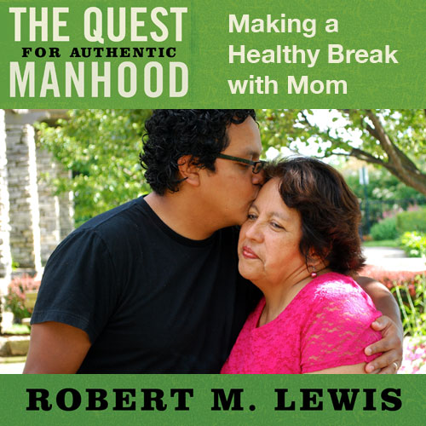
Session Eight

Slide 3
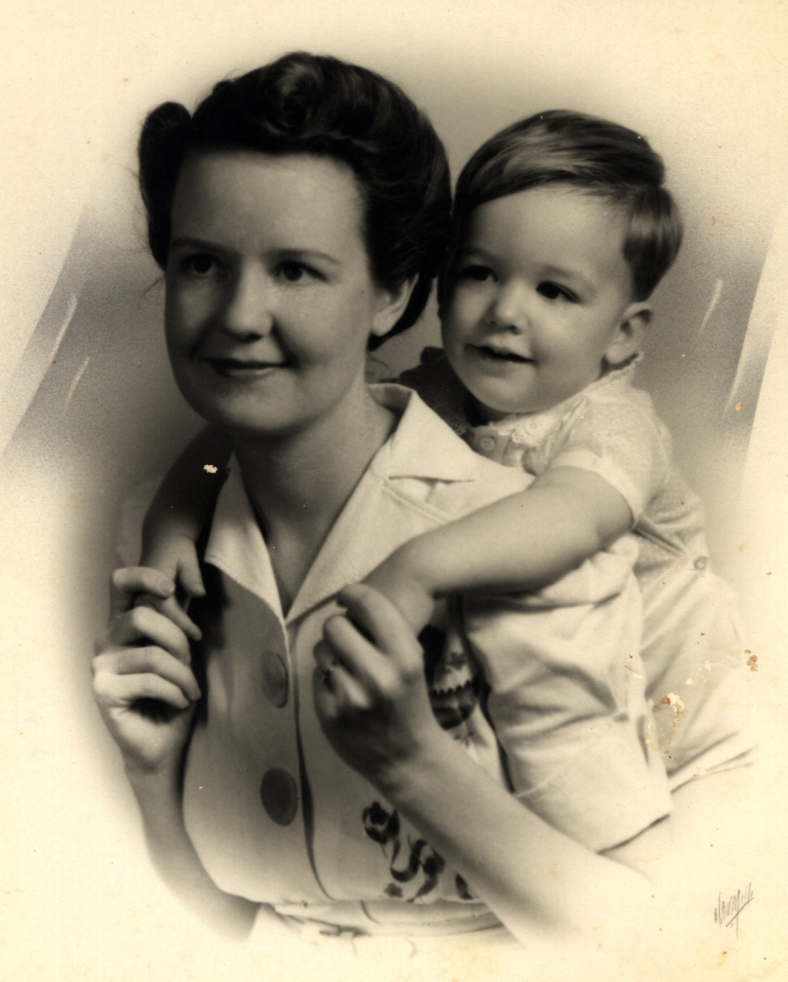

Slide 4
Review
“Legs” of Manhood
Definition of the Overly-Bonded with Mother Wound:
An unhealthy emotional relationship with Mother that causes a son to either be threatened by the influence of women later on in life or to over-identify and become submissive to that influence.

Slide 5
Review
Major Consequences of the Wound
Sons can become overly passive in regards to women.
Soft Male (fantasy/pornography)
Feminized Man
Passive Husband

Slide 6
Review
Sons can become overly dominant in regards to women.
Conquering Masculinity (in extreme cases, violence, abuse, affairs, rape, etc.)
Fierce Independence (fear of being vulnerable)
Demanding Husband

Slide 7
Jesus & His Mom
Relational Clarity

Slide 8
“And as they were returning, after spending the full number of days, the boy Jesus stayed behind in Jerusalem. But His parents were unaware of it, but supposed Him to be in the caravan, and went a day’s journey; and they began looking for Him among their relatives and acquaintances. When they did not find Him, they returned to Jerusalem looking for Him. Then after three days they found Him in the temple, sitting in the midst of the teachers, both listening to them and asking them questions.

Slide 9
And all who heard Him were amazed at His understanding and His answers. When they saw Him, they were astonished; and His mother said to Him, ‘Son, why have You treated us this way? Behold, your father and I have been anxiously looking for You.’ And he said to them, ‘Why is it that you were looking for Me? Did you not know that I had to be in My Father’s house?’ But they did not understand the statement which He had made to them.”
Luke 2:43-50

Slide 10
Jesus & His Mom
Relational Clarity
Social Clarity

Slide 11
“On the third day, there was a wedding in Cana of Galilee, and the mother of Jesus was there; and both Jesus and His disciples were invited to the wedding. When the wine ran out, the mother of Jesus said to Him, ‘They have no wine.’ And Jesus said to her, ‘Woman, what do I have to do with you? My hour has not yet come.’”
John 2:1-4

Slide 12
Jesus & His Mom
Relational Clarity
Social Clarity
Spiritual Clarity

Slide 13
“While He was still speaking to the crowds, behold, His mother and brothers were standing outside, seeking to speak with Him. Someone said to Him, ‘Behold, Your mother and brothers are standing outside seeking to speak with you.’ But Jesus answered the one who was telling Him and said, ‘Who is My mother and who are My brothers?’ And stretching out His hand toward His disciples, He said, ‘Behold My mother and My brothers! For whoever does the will of My Father who is in heaven, he is My brother and sister and mother.’”
Matthew 12:46-50

Slide 14
Jesus & His Mom
Relational Clarity
Social Clarity
Spiritual Clarity
A Healthy Ending

Slide 15
“And there were standing by the cross of Jesus, His Mother, and His mother’s sister, Mary the wife of Clopas, and Mary Magdalene. When Jesus therefore saw His mother, and the disciple whom He loved standing nearby, He said to His mother, ‘Woman, behold, your son!’ Then He said to the disciple, ‘Behold, your mother!’ And from that hour the disciple took her into his own household.”
John 19:25-27

Slide 16
Healing the Wound
Always start with the understanding that breaking Mom’s over-involvement is good for you and her. Authentic manhood is impossible without it.

Slide 17
Healing the Wound
Recognize that your ultimate goal is to become a man whose vision is fixed on what God thinks not what Mom thinks.

Slide 18
Healing the Wound
Stop complaining or struggling with Mom. If you have this wound, get the support, encouragement, and help you need from other men (or a counselor) and develop a plan for healthy independence from Mom. Invite their feedback to avoid serious errors in making a healthy break.

Slide 19
Healing the Wound
This plan should address specific issues that are troublesome with specific applications.
This plan should establish time-tested boundaries for how you and Mom will interact in the future
This plan should include clear consequences attached to boundary violations.

Slide 21
Healing the Wound
Communicate your plan in one of the following ways to your Mom and stand your ground regardless of how she responds.
Through a new way of relating.
Through a face-to-face meeting (if necessary).

Slide 22
Healing the Wound
Use the men in your life to “report back to” for clarity, encouragement, and accountability.

Slide 23
Healing the Wound
If you are married, tell your wife you recognize the problem with an interfering Mom and that you will take responsibility to correct it. Ask for her support and prayer, but ask her not to get involved. It’s your problem… not hers.

Slide 24
Healing the Wound
In some cases, your efforts to establish a healthy relationship with Mom will result in a time of emotional punishment or even your Mom’s angry withdrawal. Do not be derailed by this! In time, she will adjust.

Slide 25
Critical Need
The critical need today for
fathers is to call teenage sons away
from dependency on
Mom to manhood.

Slide 26
The Call Away
Needs to be clear and direct.
Needs to be embraced by the son, the dad, and the mom to be effective.
Needs to employ ceremony.

Slide 27
The Call Away
The “legs” of masculinity (weak or strong) on which a man stands are established at home.
Start work on your Manhood Plan Now!

